Slide 1

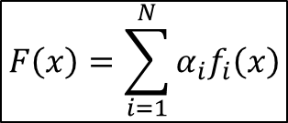



$$f_{1}(x)$$
Weak classifier 1
$$f_{2}(x)$$
Weak classifier 2
Strong
Classifier
$$F\left(x\right)=\sum_{i=1}^{N}{α_{i}f_{i}\left(x\right)}$$
Input Data
$$f_{3}(x)$$
Weak classifier 3
…………………….
Combination of weak classifiers
$$f_{N}(x)$$
Weak classifier N

